Slide 1
Assisting Customers with
Legal Research
Federal Resources
Natasha Francois
Business/Law Librarian

Slide 2
Agenda
Introduction
Types of resources
Legislation
Case Law
Rules and Regulations
All inclusive sources

Slide 3
Types of Resources
There are two main jurisdictions for legal research:
  Federal – nationwide; between two or more states
  State – within state lines
    Local – County, Municipality
Two main bodies of Law:
  Civil
  Criminal
Legal research resources fall into two categories:
  Primary Sources
  Secondary Sources

Slide 4
Primary Sources
Federal Jurisdiction
US Constitution; US Code; Case Law; & more

Slide 5
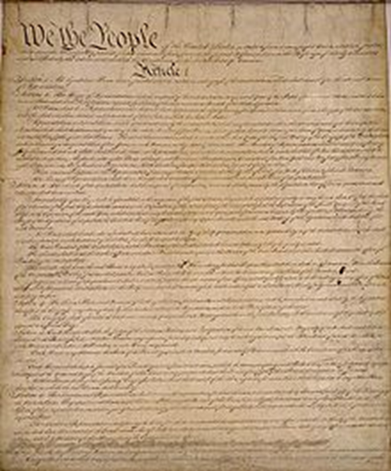
US Constitution: Main Law of the Land
Contains a preamble and seven articles.
First three articles establish branches of government and powers: Legislative (Congress), Executive (President,) and Judicial (Federal courts).
Articles four through seven describe relationship between states and Federal Government.
Notes:
Mainly refer people to the Constitution if they need information about which branch of government has what power or for some specific wording of an amendment in the Bill of Rights. Most questions dealing with the constitutionality of an issue will require the customer to search through case law from the judiciary.
NC State Constitution: https://www.ncleg.gov/Laws/Constitution

Slide 6
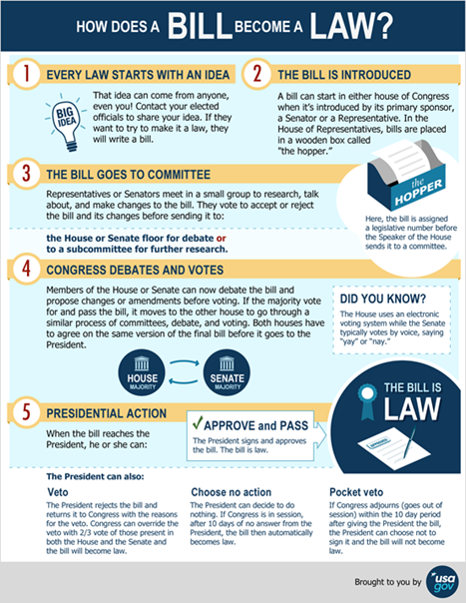
How to find laws – Legislative Branch
US Code
Congress.gov
  Legislation
  Congressional Record
  Committees
Statutes at Large
  Library of Congress (older)
  GPO (newer)
Notes:
Four types of proposals for congressional action: Bills (primary method of action), Simple Resolutions (internal chamber matters), Joint Resolutions (both chambers and approval of president), and concurrent resolutions (impact both chambers not submitted to president). Bills get approved into law. Law first released as Slip Law. Arranged in Statutes at Large chronologically by congressional session. Codified into US Code by subject matter of the general and permanent laws.
North Carolina General Assembly website: https://www.ncleg.gov/. The website contains access to the General Statutes. The best way I have found for patrons to search the General Statute is by searching the Table of Contents. Having them click through the various topics and dig down deeper sometimes helps them get a better grasps of what they are looking for. Doing a search by keyword has also worked well, though they may get confused by the search results since it will bring them to statutes on different topics.

Slide 7
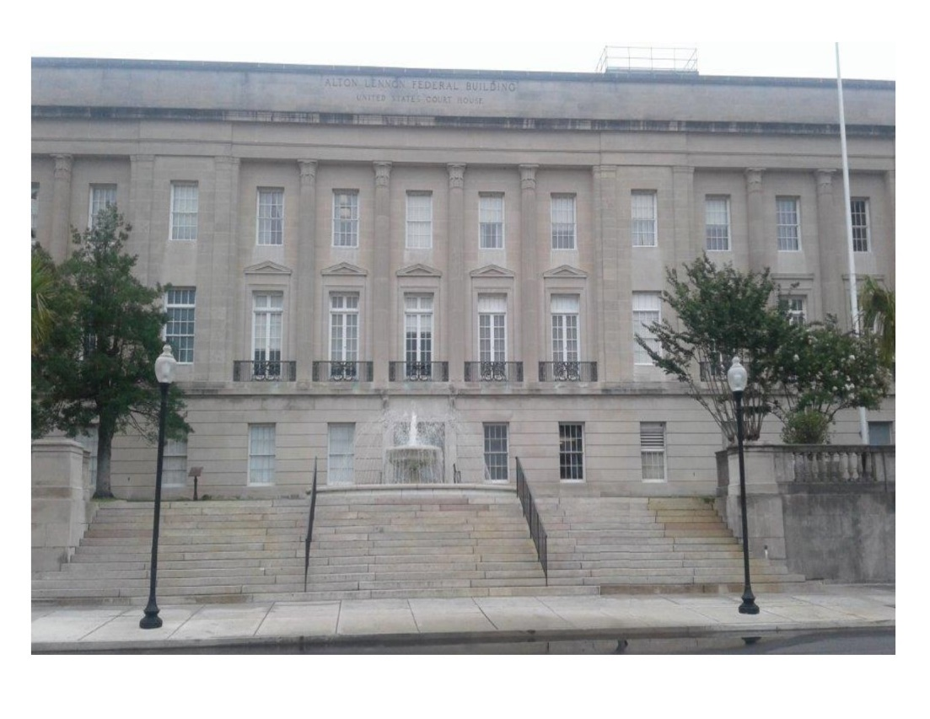
Judicial Branch: Interpret and Enforce the Laws
Supreme Court:
  Equal Justice Under the Law
  Chief Justice and eight Associate Justices
13 Circuit Courts of Appeal:
  3 judge panel decide cases on appeal
  Hear challenges to district court decisions
94 federal district courts
Notes:
North Carolina has: the North Carolina Supreme Court, 15 Court of Appeal judges hear cases in 3 judge panel, Five division and 48 Superior Court districts, and 41 District Courts plus the specialty courts.

Slide 8
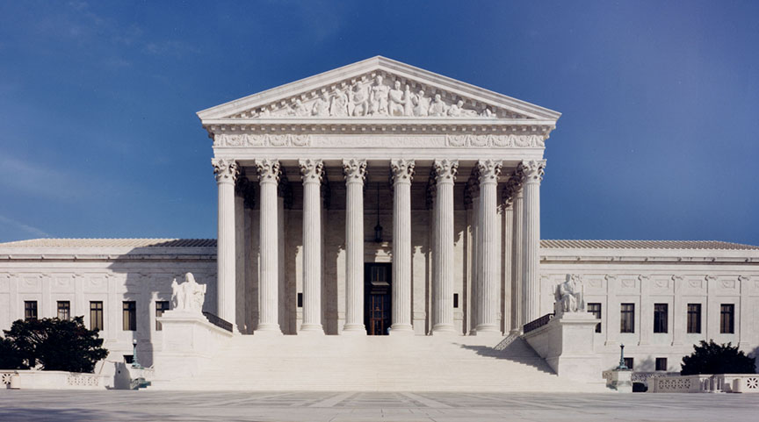
Finding Supreme Court Resources
Supreme Court website
  Opinions
  Transcripts
  Orders
  Journal of the Supreme Court
US Reports
  Findlaw
  Legal Information Institute
Briefs
  American Bar Association
Notes:
North Carolina Supreme Court information is listed under the North Carolina Courts website listed in the notes on the next slide.

Slide 9
Where to find case law
Online
Print
PACER
Findlaw
Justia
Federal Reporter
South Eastern Reporter
Notes:
North Carolina Courts: https://www.nccourts.gov/. Has access to forms and services offered by the courts. During the presentation I could not remember where the opinions for the Appellate courts were held (either on the court’s page or the State Archives); however, they are linked through the courts website under documents. The link to those opinions is https://www.nccourts.gov/documents.

Slide 10
Where to find Presidential and Agency Docs
Executive Branch
Online Resources
President Powers:
  Proclamations
  Executive Orders
Federal Departments and Agencies
  Rules
  Regulations
National Archives
  Federal Register
Government Printing Office
  Government Manual
  Code of Federal Regulations
White House website
Department or Agency website
Notes:
Difference between the Federal Register and Code of Federal Regulations is as follows: Federal Register is the unofficial daily publication for rules, proposed rules, and notices of Federal agencies and organizations, as well as executive orders and other presidential documents; however, the Code of Federal Regulations is just the annual codification of the general and permanent rules that were listed in the Federal Register. So the Federal Register has everything including proposed rules; Code had just the actual rules.
NC Governor website: https://governor.nc.gov/. NC.gov is the probably the best website to use to link out to the other state resources you would need. North Carolina State Archives also has some great government information as well: https://archives.ncdcr.gov/

Slide 11

Government Printing Office: All-in-One Access
United States Code
Congressional Record
Statutes at Large
Federal Register
Electronic Code of Federal Regulations
US Government Manual
Supreme Court Cases

Slide 12
Secondary Sources
Federal Resources
Legal Encyclopedias, ALR, and more

Slide 13
Secondary Sources
Multiple Legal Topics
Other Resources
Legal Encyclopedias
  American Jurisprudence
  Corpus Juris Secundum
American Law Reports
Hornbook/Treatise
Form Books
American Bar Association Journal
Lawyer’s Weekly
Law Review Journals
Notes:
Some state resources are the North Carolina Bar Association; North Carolina Law Review, and UNC School of Government Publications.

Slide 14
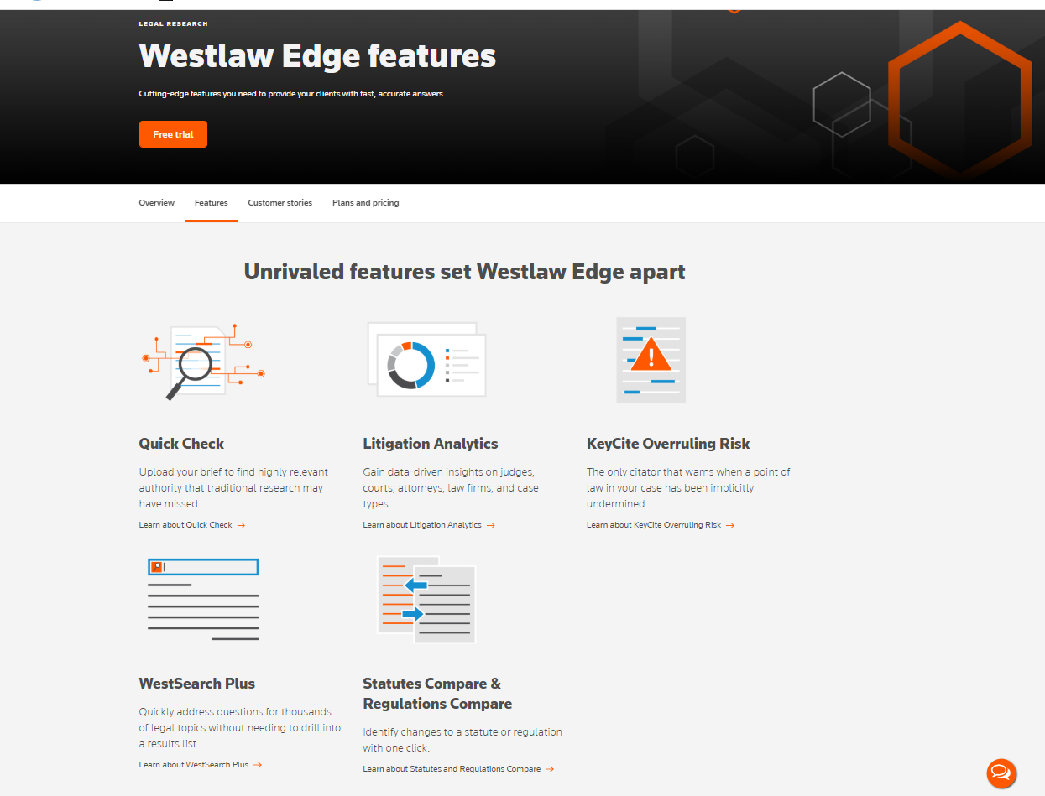
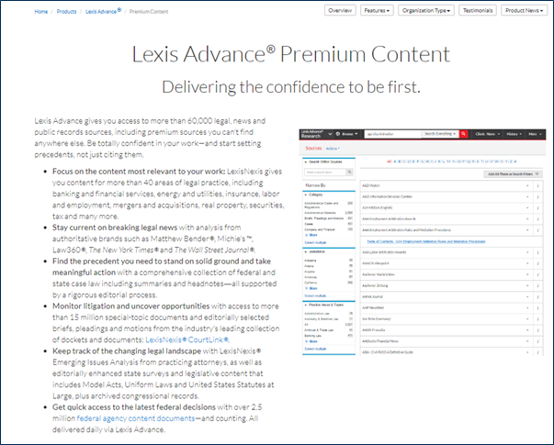
Legal Databases
One Stop Searching for Primary and Secondary Sources
Thompson Reuters Westlaw and Lexis Nexis
Notes:
These resources contain information for all states as well as federal resources.

Slide 15
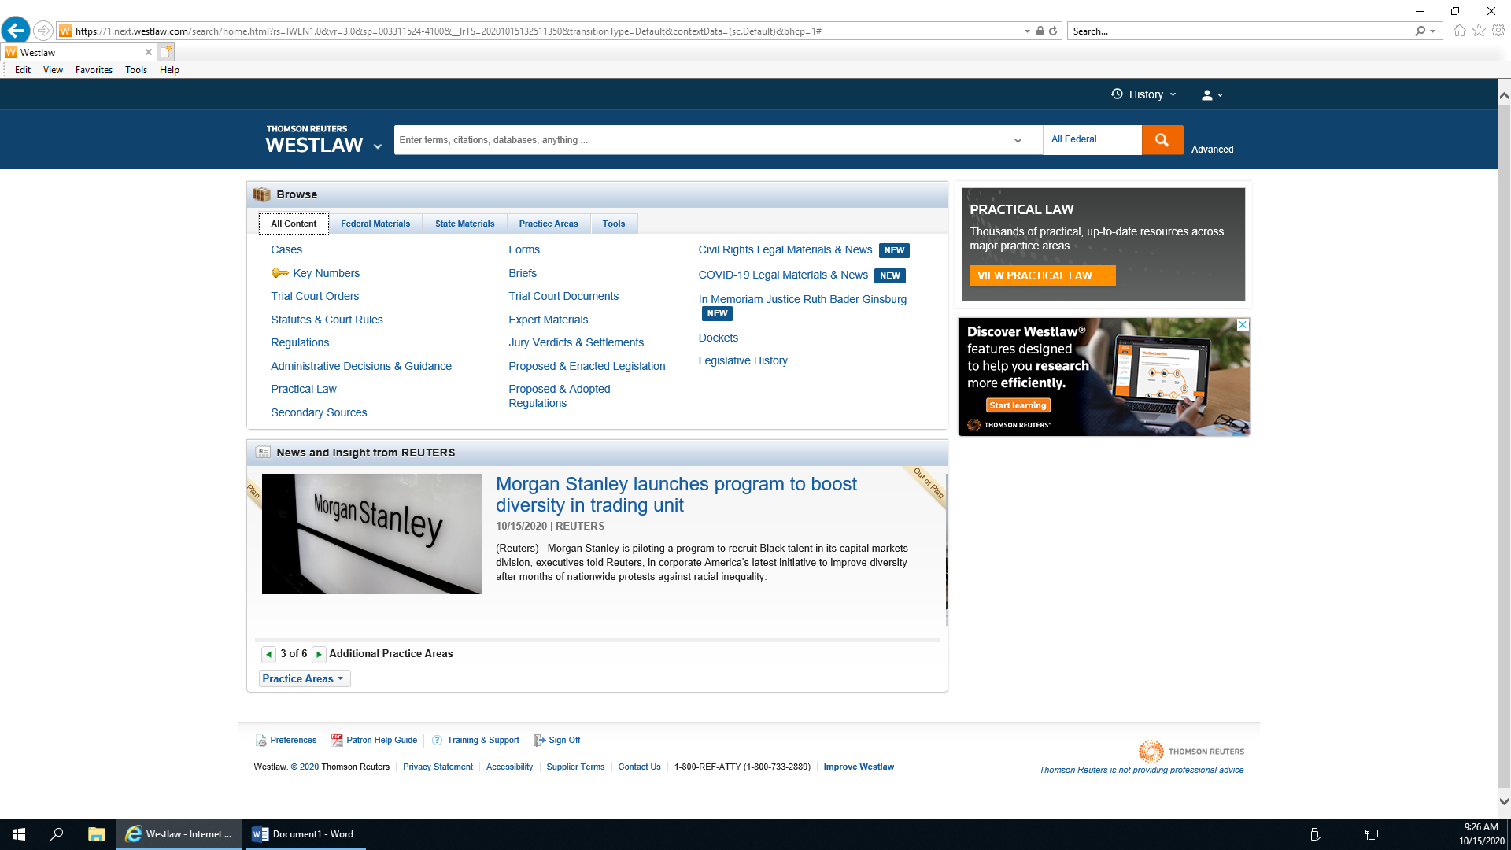
Legal Databases Sample Pages – Westlaw Edge
Notes:
You can see here in Westlaw there is a State Materials tab that will provide access to information by state as well.

Slide 16
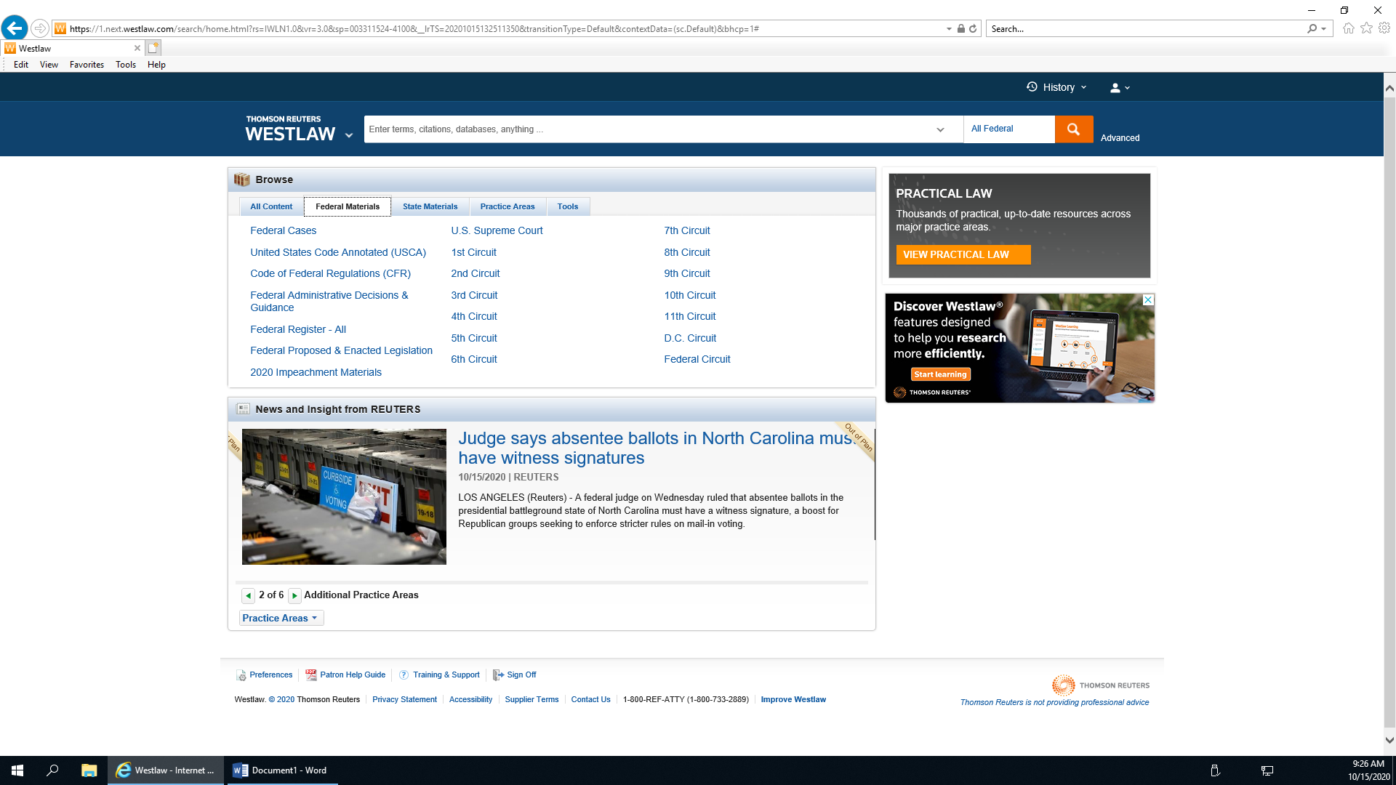
Legal Databases Sample Pages – Westlaw Edge

Slide 17
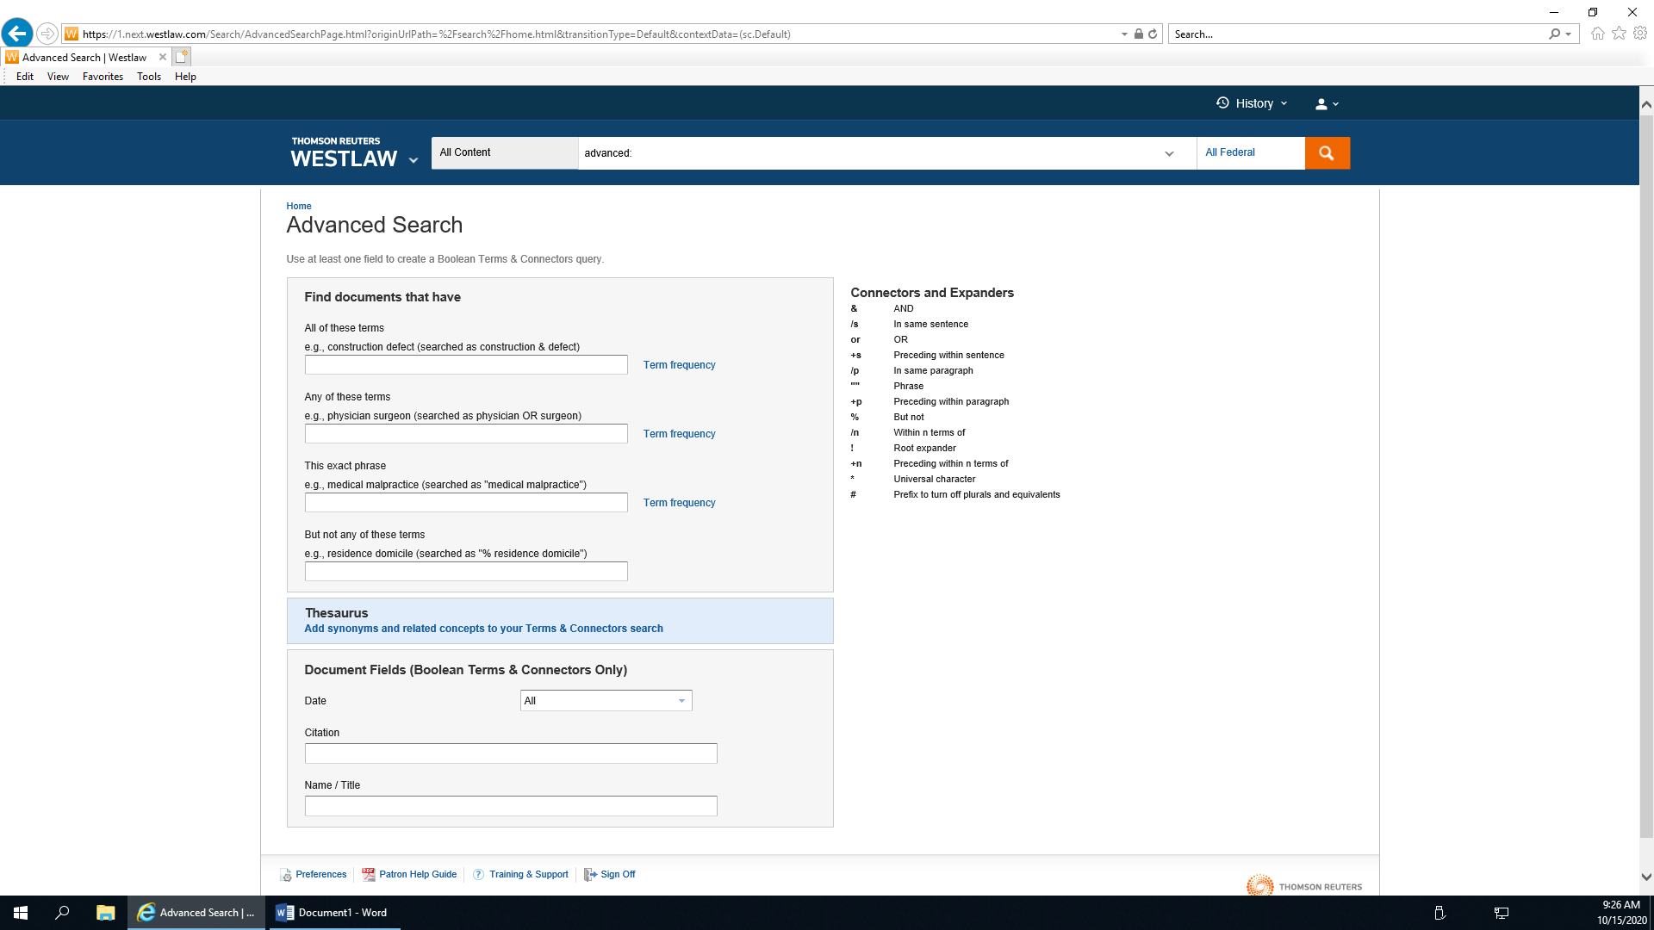
Legal Databases Sample Pages – Westlaw Edge

Slide 18
Other great resources
Library of Congress Law Library: https://www.loc.gov/law/find/
New Hanover County Public Law Library: https://libguides.nhcgov.com/legalgov
UNCW Randall Library Government Resources: https://library.uncw.edu/gov_docs
Notes:
Legal Aid of North Carolina or Pisgah Legal Services (depending on the county you are in) has great resources to general legal information as well. https://www.legalaidnc.org/ and https://www.pisgahlegal.org/

Slide 19
In Conclusion: Things to consider
Things to consider when assisting someone:
What jurisdiction are they looking for? (fed., state, local)
What type of information are they looking for? (law, case)
Which body of law or subject area do they need? (civil vs criminal, contracts, family, etc.)
Do they have a specific citation or resource in mind?
If the topic is not narrow enough, start with a secondary source to try to narrow down the focus.
Notes:
Thank you for time. Have a great day.

Slide 20
Natasha Francois
Business/Law Librarian
Main Library
nfrancois@nhcgov.com
Office: 910-798-6355
Law Library: 910-798-6306

