Slide 1
Project Management:
Tips and Tools
Laura K. Wiegand
Associate Director, Library IT & Digital Strategies
UNC Wilmington

Slide 2
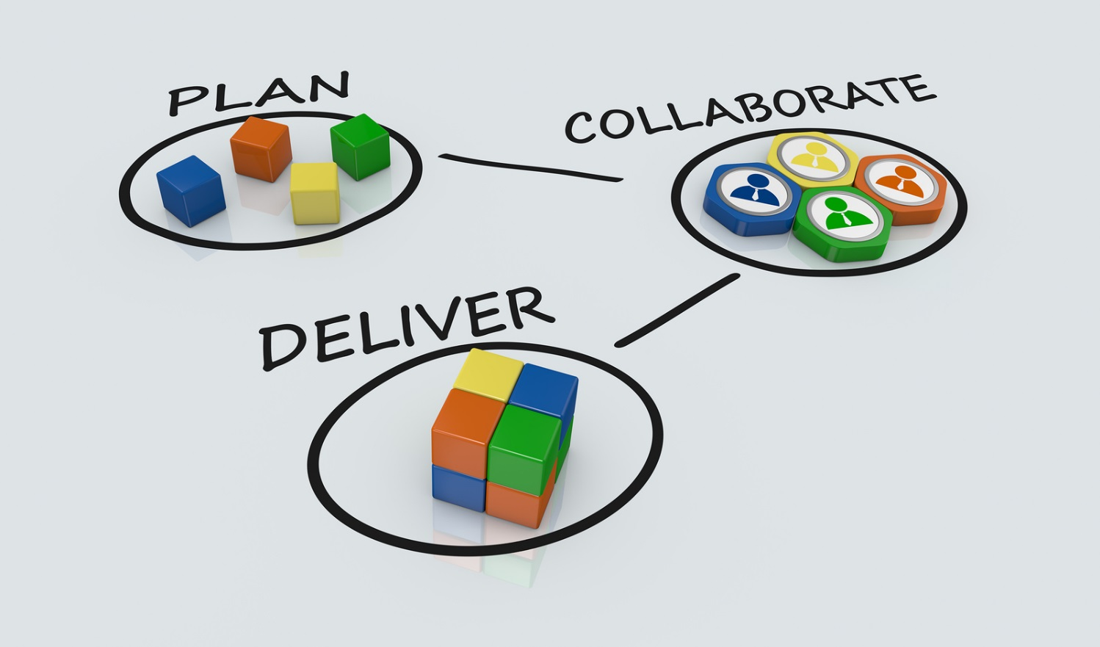
What Project Management is...
Process with distinct stages
Planning, planning, planning
Resource (time, things, people)
management
Work (tasks, assignments, objectives)
management
Soft skills: team work & leadership

Slide 3
What Project Management is...NOT
Using project management software
Time management
Meetings and collaboration
But doing these things well are the tips and tools

Slide 4
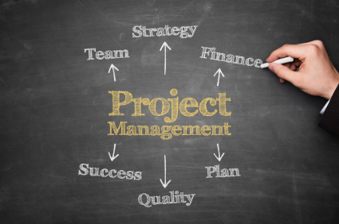
What is a (Successful | Failed) Project?

Slide 5
What is a Project?
Projects have:
A beginning and an end
Involve a team
A series of deliverables leading to a final outcome

Slide 6
What is a (Successful | Failed) Project?
Completed
On-time
Goals and objectives met
Stakeholders happy (boards, supervisors, patron/customers, students)
Within budget

Slide 7
Tip: Identify what success Looks like
To know if you are successful, need to pre-identify what "complete", "on- time", and "happy" all mean.
*Tools coming later

Slide 8
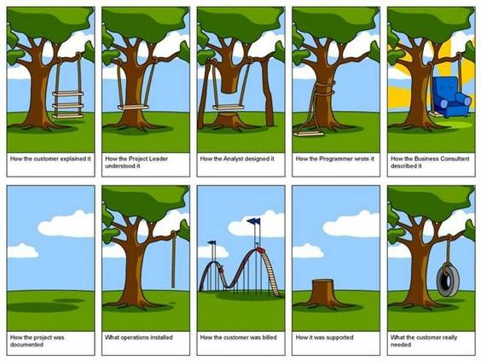
What is a (Successful | Failed) Project?

Slide 9
What is a (Successful | Failed) Project?
When goals, timeline, tasks are unclear or unrealistic
When the Team is non-existent, dysfunctional, or unorganized
Project manager isn’t given resources (authority, time, budget)
Scope creep

Slide 10

Tip: Planning should come first

Slide 11
Planning Tools – Project Charter
Create a Project Charter - Toolkit http://project-charter-template.casual.pm/
  Signals the beginning of the project
  Name of Project
  Description of Purpose
  Identifies Stakeholders
  Identifies Project Manager
  1-2 pages
  Share It!

Slide 12
Planning Tools – Scope Statement
Create a “Scope statement”
Describes the goals of the project, including specific deliverables
Includes what will NOT be part of the project
Template: Objectives, Milestones, Assumptions, Constraints, Boundaries, Acceptance criteria (quality), Risks
Helps bring team members and stakeholders in alignment
Share It!

Slide 13

Tip: Break down project into tasks

Slide 14
Tools: Identifying & Mapping tasks
Post-Its brainstorming
Simple Lists
Flow Charts – Gliffy https://www.gliffy.com/
Gantt Charts – Excel template, Microsoft Project, Tom’s Planner http://www.tomsplanner.com/

Slide 15
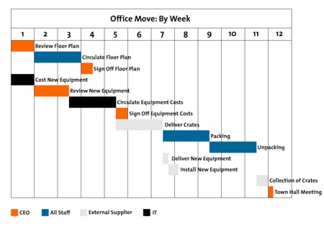
Gannt Charts
To track tasks over time
explanation:
https://www.mindtools.com/pages/article/newPPM_03.htm

Slide 16
Tip: Communication is key
“Highly effective communicators are also more likely to deliver projects on time (71 percent versus 37 percent) and within budget (76 percent versus 48 percent).” Source

Slide 17
Tip: Use Effective Communication
Effective communication means that the information is provided in the right format, at the right time, to the right audience, and with the right impact*
From “Guide to the Project Management Body of Knowledge (PMBOK®Guide)”

Slide 18
Tip: Use Effective Communication
Provide updates to stakeholders and team members
Managing meetings
Address conflicts – Learn conflict resolution and Negotiation skills
Track and share task progress
Use communication & collaboration tools

Slide 19
Meeting Management tools
Virtual Meetings (join.me, Google Hangouts, Skype)
Collaborative Document Space (Google Docs)
Agendas (Ahead of time)
Moderation (Clock)
follow-up Communication (of what was decided/next steps)

Slide 20
Tools: Communication
Unison https://www.unison.com/
Slack https://slack.com
Google Groups https://groups.google.com

Slide 21
Tools: Task Management & Communication
Asana https://asana.com
Basecamp https://basecamp.com/
Trello https://trello.com/
Google (Groups, Docs, Sheet)

Slide 22
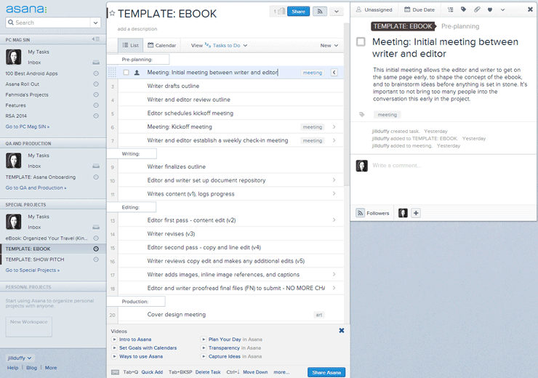

Slide 23
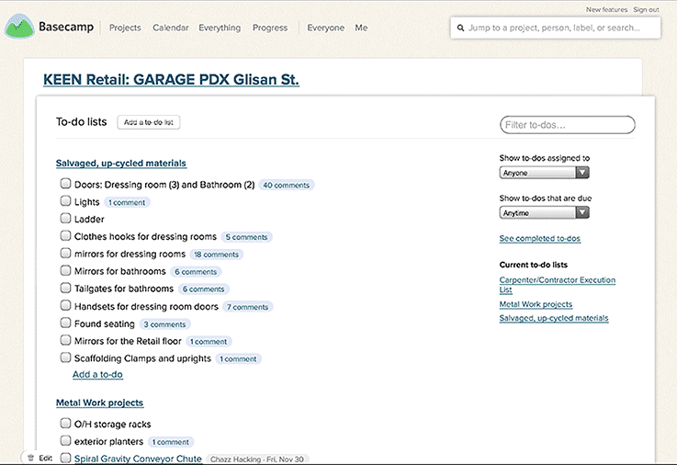

Slide 24
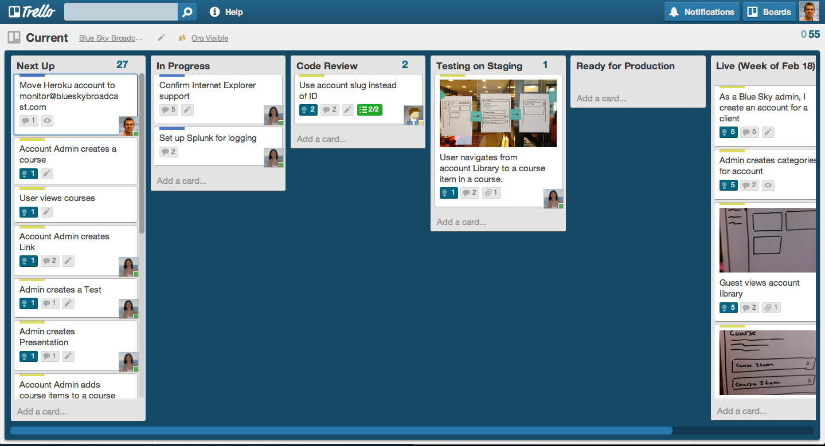

Slide 25
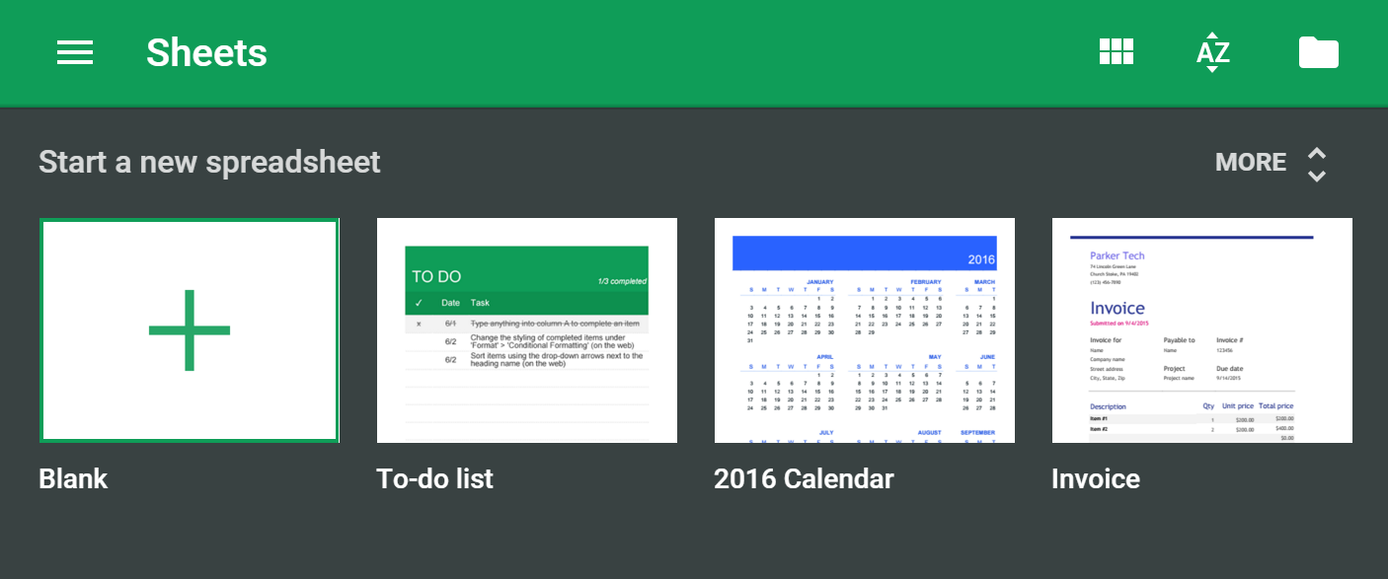

Slide 26
Tip: Make effective use of the tools you have
Choose your tool carefully
Think about your team members
Use what you have
Provide training/orientation

Slide 27
Other Tips and Tools to share?
Questions?
Thank you!

