Slide 1
NC LIVE
Update
4-22-2016
Wilmington, NC
Rob Ross
Executive Director
NC LIVE

Slide 2
Agenda
What is NC LIVE.
How NC LIVE works.
Value proposition.
What’s happening.
How to stay engaged.

Slide 3
What’s NC LIVE?
It’s a Mission
“NC LIVE helps member libraries to better support education, enhance economic development, and improve the quality of life of all North Carolinians.”

Slide 4
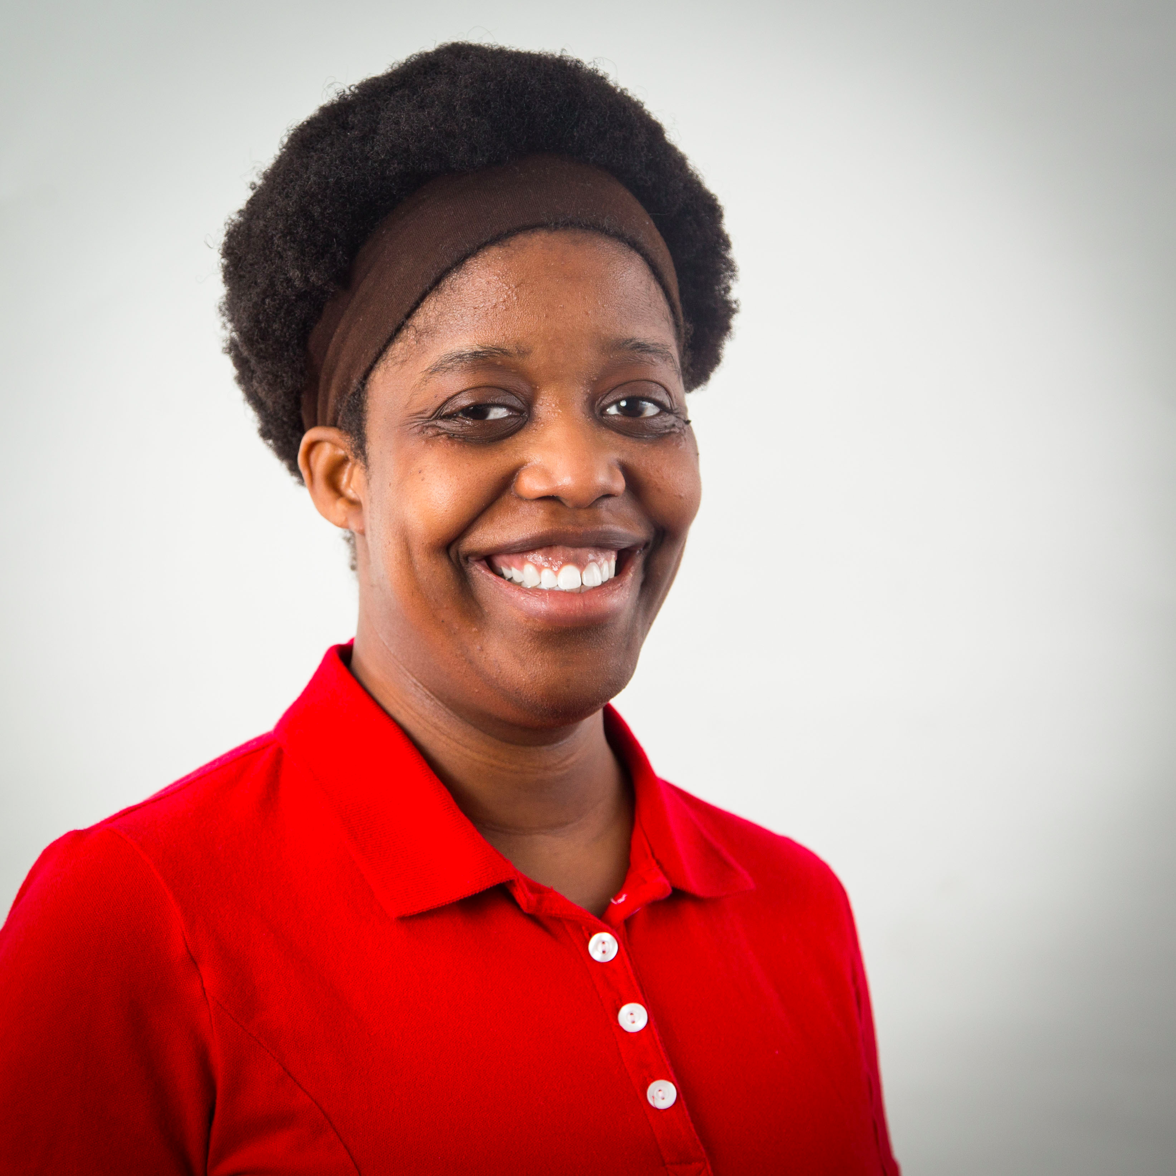
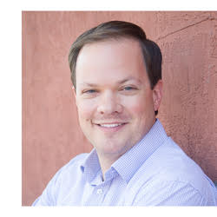
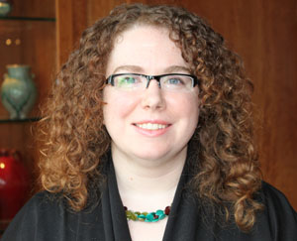
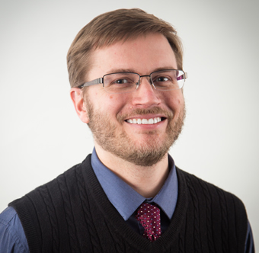
What’s NC LIVE?
It’s a Team (on a mission)
Erin Holmes
System Librarian
Rob Ross
Executive Director
Heather Greer Klein
Member Services Coordinator
Josh Wilson
System Librarian

Slide 5
What’s NC LIVE?
It’s a community
200 libraries
4 communities of interest
  Community Colleges (CCs)
  Independent Colleges and Universities (NCICU)
  Public Libraries via State Library (PL)
  UNC System Libraries (UNC)

Slide 6


What’s NC LIVE?
It’s YOUR community
200 Member Libraries
Librarians Council
4 Communities of Interest
NC LIVE Staff
Advisory Committees

Slide 7
Your representatives
Librarians Council:
UNC System | Community Colleges | Public Libraries | NCICU
Susan Nutter, NCSU | Suvanida Duangudom, Wake Technical CC | Ruth Ann Copley, Davidson County Public Library | Kathy Winslow, North Carolina Wesleyan College

Slide 8
How is NC LIVE funded?
$4.2 mil
State Library
$1.3 mil
CCs
$0.5 mil
NCICU
$0.7 mil
UNC System
$1.7 mil
$3.60 Content
$0.6 Operations

Slide 9
What you get
It’s a massive virtual library
Access to 483,491,528 articles, ebooks, videos, etc.
$22 million worth of content for $4.2 million.
Accessible online anywhere on any device.
Access to free off-campus proxy service.
HelpDesk support.
Exclusive access to all other NC LIVE products & services.

Slide 10
How is content selected
of
CCs
NCICU
Communities
Interest
NC LIVE Core Collection
UNC
Syst.
PLs

Slide 11
Role of NC LIVE
Every 3 years, we select content on behalf of membership.
Goal: Get as much quality content as we can for our money, with equal consideration to all 4 communities of interest.
We cannot purchase everything.
Content not purchased automatically goes to CC for negotiation.

Slide 12
What’s happening
EZproxy available to members at no cost.
Additional 1,000 eBooks added to Home Grown collection.
Potential to add new COI called NCAIS.
NC LIVE to launch new Training Program.
Website redesign.
Annual Meeting – May 23
Impact Campaign

Slide 13
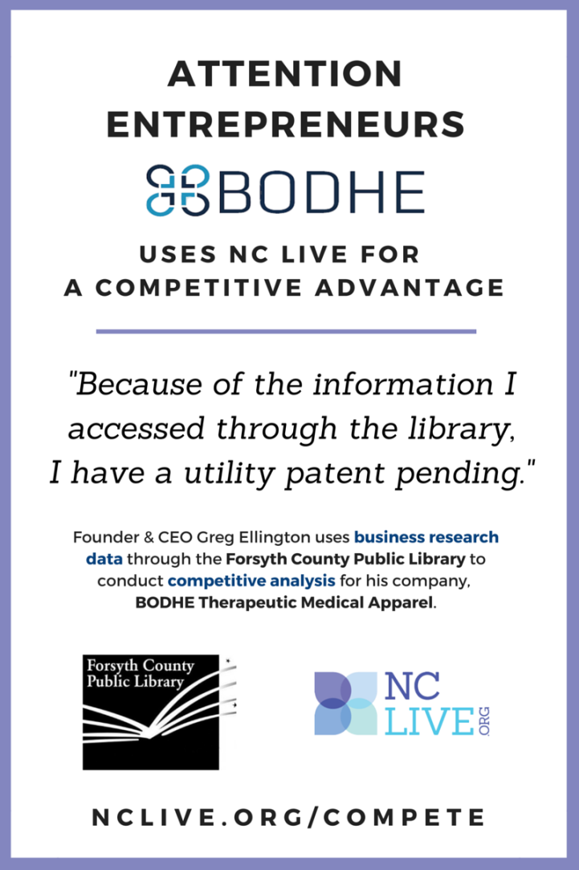
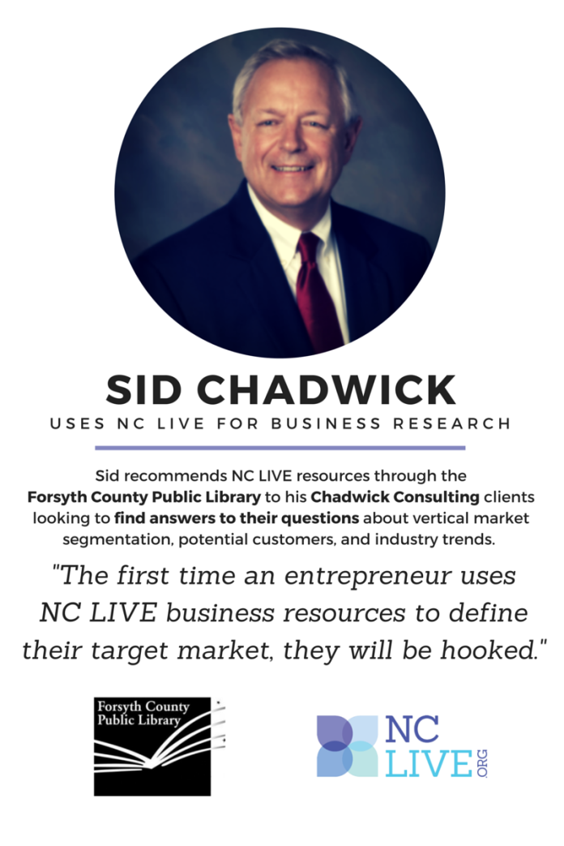
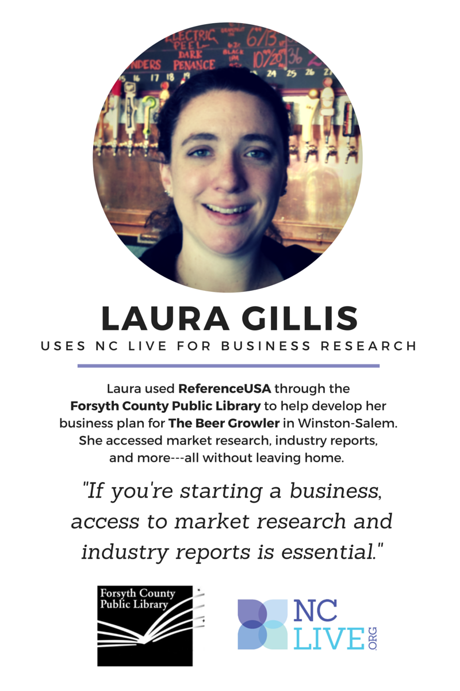
Notes:
*[link to doc]
Impact campaign to include rebranding as well as financial impact assessment results and individual patron profiles. Will seek pro bono assistance from local Ad Agency.
Examples:
Dollars Saved: http://library.uncg.edu/carolinaconsortium/ “The total amount the members paid to participate in the consortium deals was two hundred and forty million dollars less than if the member institutions had each paid independently.”
Visual example: http://www.pretzellogic.org/wp-content/upload/Dollar-Shave-Club.jpg
Lives Changed: https://www.youtube.com/watch?v=1v_06b1cid4 or http://www.redcross.org/stories/
Knowledge available:

Slide 14
Additional info
Visit NCLive.org
Attend Annual Meeting on May 23
Get involved: Serve on a committee
LinkedIn with me
Rob’s Blog: http://www.nclive.org/blogs/rob
E-mail: rob@nclive.org

