Slide 1
Emergencies Happen:
Being Prepared for Anything
Patricia Dew
Supervising Librarian
New Hanover County Public Library
April 22, 2016

Slide 2



Who am I to be presenting this?
First Aid/CPR/AED
CERT member
Army Reserve soldier
Preparedness aficionado
Librarian for over 15 years
Notes:
First Aid/CPR/AED since ~1999. Hands-only CPR train-the-trainer. Army combat first aid training.
CERT in Durham and NHC. Fire, search & rescue, medical, ICS, etc.
Army: WLC, BNCOC, ALC, SLC
Prepared, not a “prepper” ☺
Librarian in urban library with homeless, gangs, seniors, kids, non-English speakers, you name it

Slide 3
What is a library emergency?
Small stuff – disruptive patron, medical issue
Big stuff – fire, bomb threat
HUGE stuff – tornado, plane crash
Notes:
What happens in libraries? ☺ Public, academic, special, wherever…. Stuff happens.
SMALL = medical issues b/c only involve 1 person; disruptive patron usually only 1-2 people involved
BIG = fire, gas leak, active shooter : involve whole building but not entire area
HUGE = involve a large area not just your building/facility

Slide 4
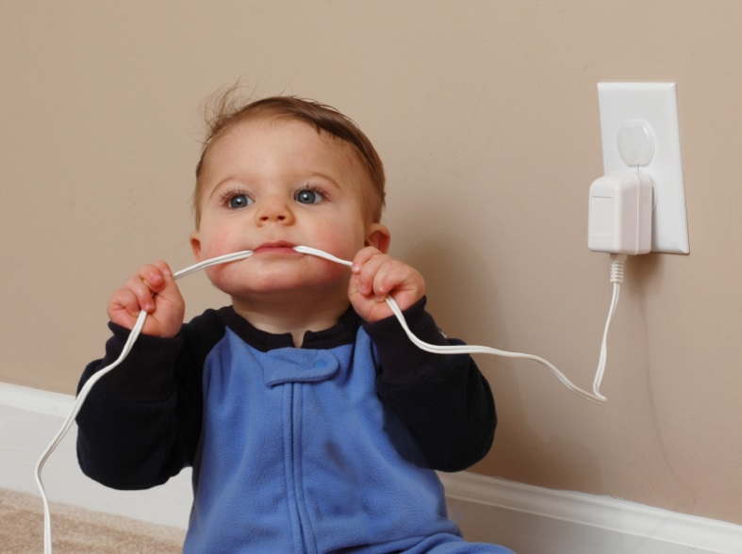
Before anything happens
Can you prevent it?
Can you mitigate it?
What’s your plan?
Notes:
This is why we’re here today!

Slide 5

Planning
Think about what to do NOW so you don’t have to think when an emergency happens.
“Prior Preparation and Planning Prevents Poor Performance”
Notes:
Know what your options are BEFORE you need to know. When you’re panicked you will FREEZE unless you have a plan.
(Hollywood version of panic = running around screaming. Real-life version of panic = frozen; no reaction)

Slide 6
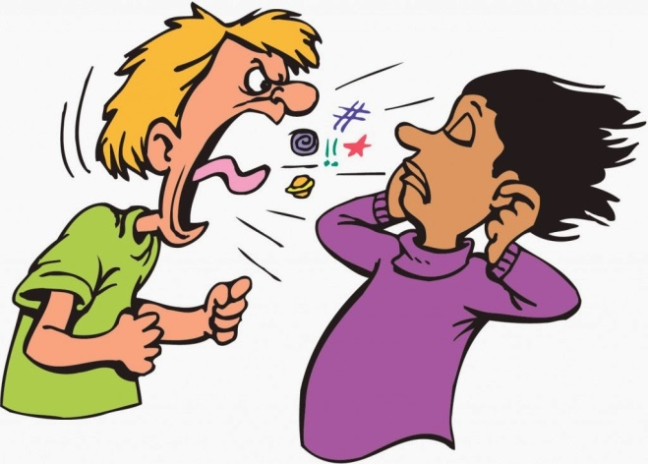
Mitigation
What can you do NOW to prevent something from becoming a big problem LATER?
Notes:
Situational awareness!
Angry patrons usually only get angrier
‘something’s not right’ – listen to your gut
Look out for your coworkers
Call 911 for EMS sooner rather than later
Weather radio; first aid kit; AED; panic button; flashlights

Slide 7


Planning: Two Basic Responses
Shelter in place
Evacuate
Notes:
99.9% of the time you’re either going to hunker down or you’re going to get the heck out of Dodge.
Fire = evacuate
Tornado = shelter in place
Active shooter = depends (run – hide – fight)

Slide 8
Planning
Evacuation routes? Rally point?
Where to shelter in place?
Security options – guard, police, manager
First aid kit, AED, trained staff?
Notes:
Things to think about IN ADVANCE:
Evacuation plans, rally point?
Shelter options?
Security guard, police, panic button, who’s in charge?
First aid options
Know what your options are BEFORE you need to know. When you’re panicked you will FREEZE unless you have a plan.

Slide 9

Evacuation
Know your building’s evacuation routes and rally point
Help patrons to evacuate if possible
Leave personal belongings behind!
Notes:
Library activities STOP when you have to get out. That means hang up the phone in mid-conversation. Really.
Assist patrons but don't sacrifice yourself to assist others. Generally speaking, assist children & those adults who need help; leave the able-bodied adults to help themselves.
Don’t go grab your purse, coat, etc. – those things are replaceable; you are not!

Slide 10

Shelter in Place
Know your location’s safe areas
  No windows
  Secure door
Assist patrons in getting to shelter
Notes:
Tornado shelter = interior room, no windows. Bathrooms, closets, hallways
Active shooter = add a door that you can secure to prevent access by the shooter [run, hide, fight]
Wait for an All-Clear before leaving shelter

Slide 11

Medical
Know where your first aid kit & AED are located
Who is trained on your staff?
Call EMS/911 if you even *think* you need them
Crowd control is important
Notes:
You do have a first aid kit, right?!?!
Don’t worry about aspirin, Tylenol, antihistamines, etc. because they will expire and could cause allergic reactions
Keep band-aids, tape, gauze, tweezers, bandages, gloves
AED and Hands-Only CPR are important – get someone trained, but even a layperson can use a modern AED
CROWD CONTROL – Library functions stop. Get extra staff to help with crowd control, meeting/guiding the ambulance, etc.

Slide 12

Questions
What are your questions, concerns, worries?

Slide 13
Contact information
Patricia Dew
pdew@nhcgov.com
910-798-6228

