Slide 1
Advertising the Library by Hook, Crook and Internet
June Power, UNCP
Robert Arndt, UNCP

Slide 2
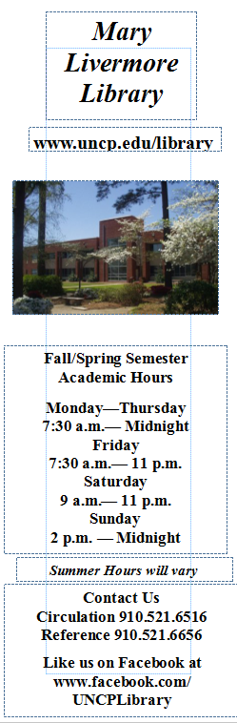
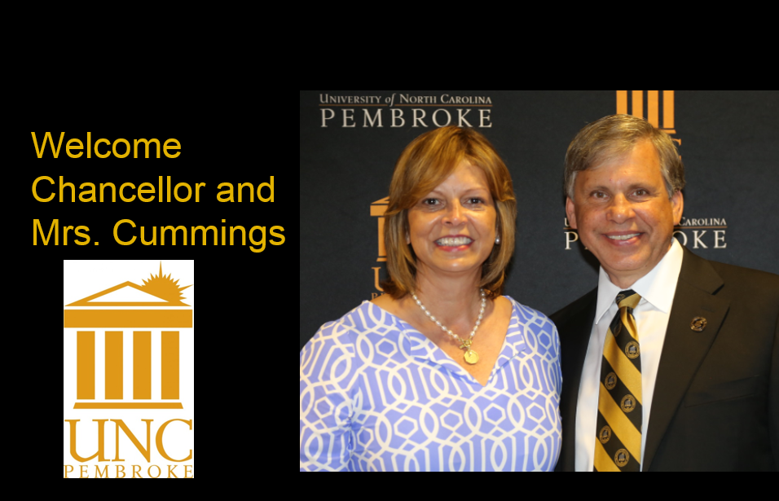
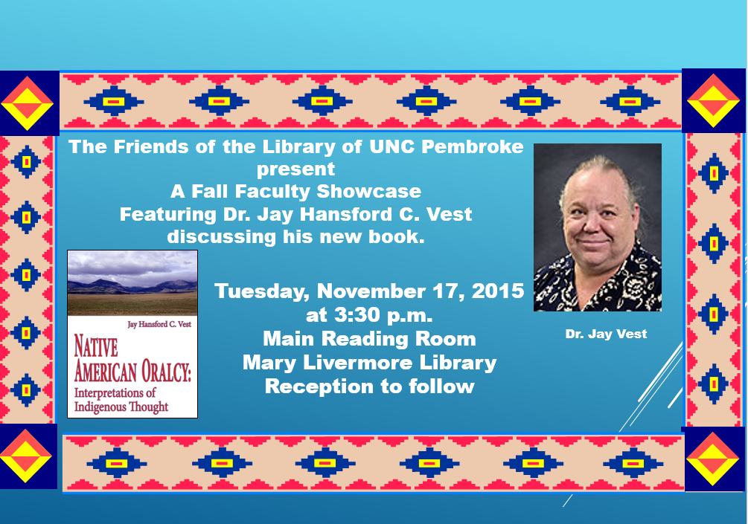

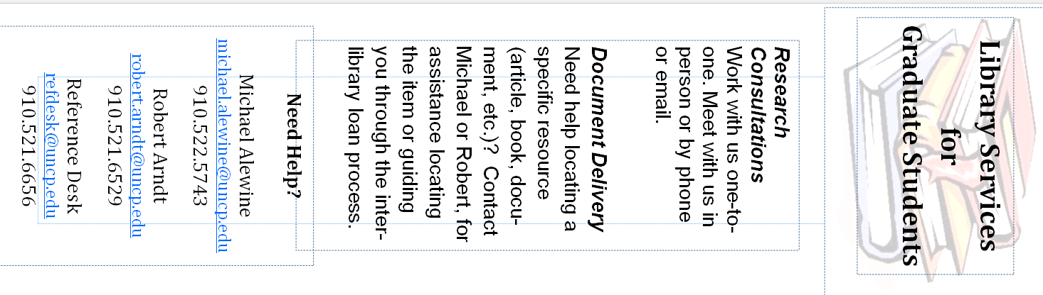
Advertising Using Traditional Means
Powerpoints on a Message board and Bookmarks
Robert Arndt, UNCP

Slide 3

Advertising the Library – Simple and FUN!
Be Creative!
Keep it Simple!
Make it FUN
ANIMATE!

Slide 4
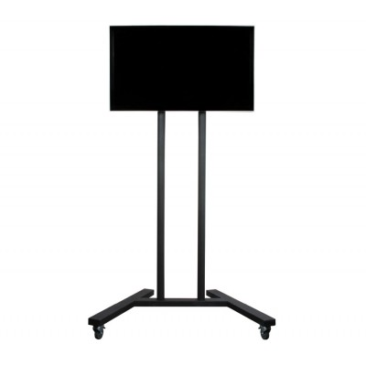
Powerpoint Display at UNCP
Materials
Large screen TV
TV stand
Computer
Presentation software

Slide 5

Multiple versions of each slide.
Most slides are repeated with different backgrounds, different images, but may have the message repeated. If you present the same slide repeatedly your audience will soon tune it.
If you change the background, animations, transitions, and images, you have a better chance of attracting attention.
The colors and animation that may attract one person may not attract the other.

Slide 6
The type of slides I have at UNCP can be divided into 4 categories;
Welcome
Services
Reference
Circulation
New Books
New Resources
Programs/Events
Friends of Library
University/Community
Policy

Slide 7
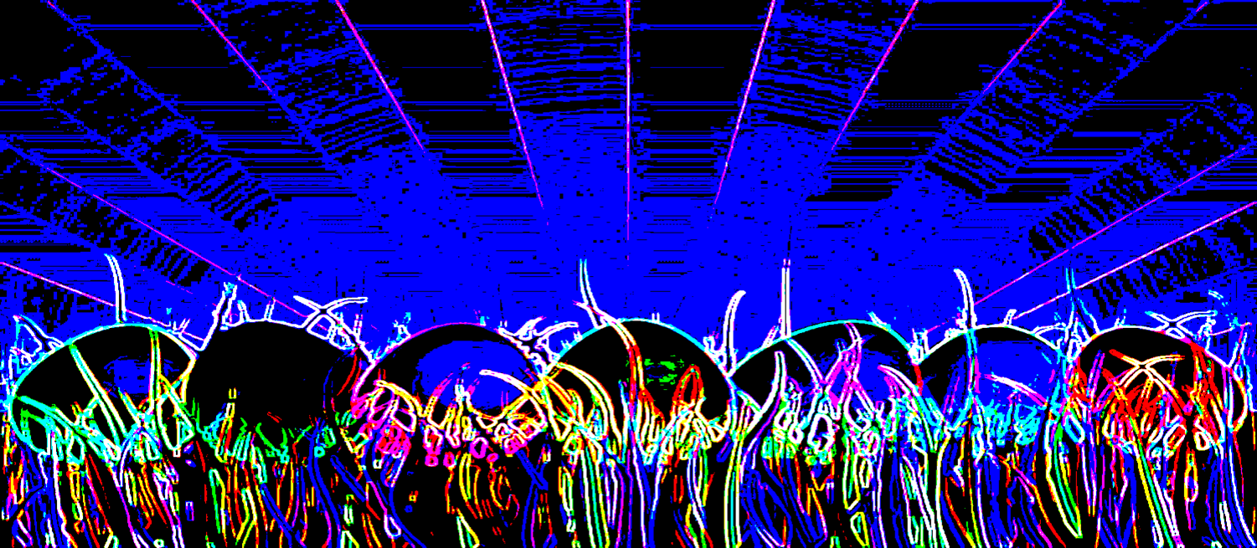
Welcome slides are that. I use 2 types. One with the image of the outside of our library and a generic welcome with clipart.
You will also want to advertise services. I have slides for Reference, Circulation, and ILL.
These are the services that most of patrons will use. I will highlight new databases, new books occasionally.

Slide 8
Programs and Events
I use this slides to promote author readings and other events—early closings, and other change in hours.
Friends of the Library
If you have an organization like, use your slide show to promote it.
In my slides I have very few sacred cows where I will not clipart or animation. This is one. Most directors, deans and other leaders take the Friends of the Library information seriously. To me, that makes these slides are sacred cows. I have not touch the FOL slides since their inception and probably will never. Program or event slides I will not animate or put clipart on. While animations and clever clipart might attract attention, it could seem insulting to the event staff or people on the program. As a library we cannot afford to insult people like this. The other sacred cow I have are Chancellor related slides. Do not tic off the big bosses.

Slide 9
Policy slides
Use these slide to remind people of Library policies—food, cell phone use, returning of laptops, Study room procedures.
University and community
Depending on the event I post these slides. I post information about the Writing Center and events of a literary nature that occur on campus or in the community.

Slide 10
Needless to say , I use Powerpoint at the primary program for the slides. The great thing about PowerPoint 2013 is it has lots of slide transitions and animation feature. The bad news is the Clipart that was with previous version is no longer there. Most of the clipart I used was from this feature. Now Powerpoint 2013 has the Bing image search. For straight clipart, I use it.
For backgrounds, sometimes I like to get creative. Look online for crystal and biology slides. You can use the Format Picture feature to modify them or I have also use SnagIT to modify images by using color substitution, or inverting colors. This creates a different look and feel.

Slide 11
Ways to attract attention
Vary backgrounds
Seasonal graphics or images
  Remember any seasonal imaged added must be removed
Vary transitions on slides
Use co-workers in images/slides
Animate strategic text and graphics
  Use slow speeds on animations
  Stagger animations
Slide length should be 15-20 seconds- Don’t let viewers get bored
ADAA compliant– contrast between background and text

Slide 12
SaMPLE sLIDES
S

Slide 13
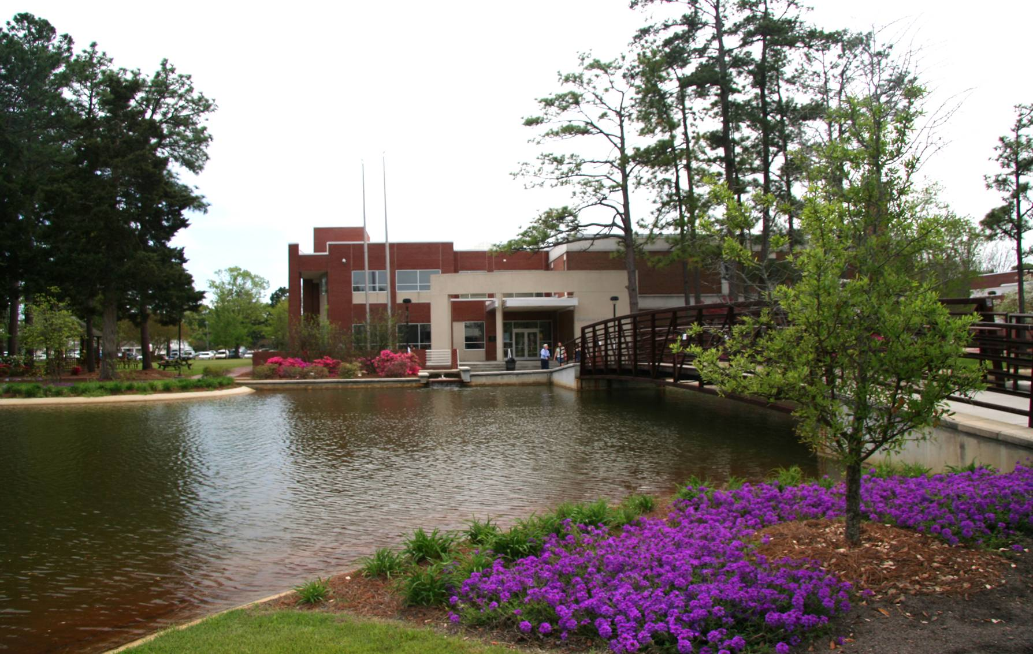


Welcome To:
The Mary Livermore Library

Slide 14

Support the Friends of the Library
Applications are available at the Circulation and Reference Desks.
“A little library growing each year is an honorable part of a man’s history” –Henry Ward Beecher

Slide 15


If we don’t have the item you want…
…ask Document Delivery!!
Just click on “Request Materials” from the Library’s web page and we’ll borrow them for you.

Slide 16


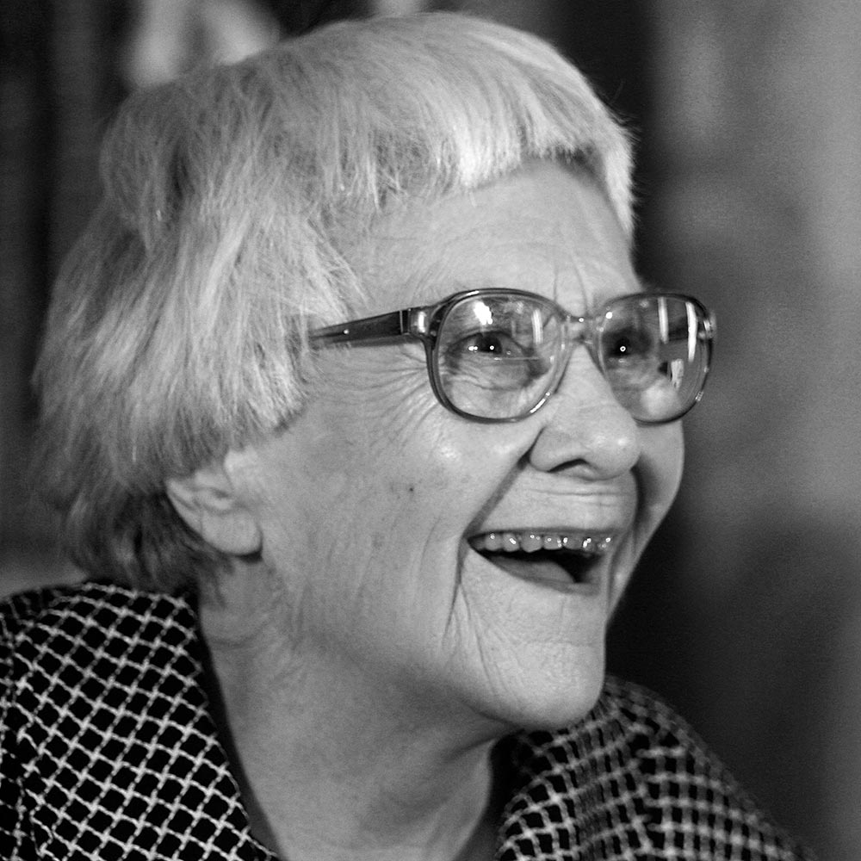
Exploring
Harper Lee:
The Dichotomy of Atticus Finch
Library Fund Raiser
Friday, April 29

Slide 17



Guest Wireless Access
NOW
Available!
Search Wireless in the UNCP search for access instructions

Slide 18
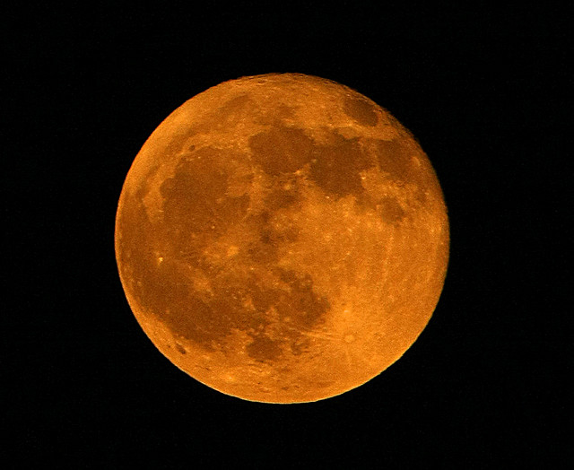
Exam Hours
Monday, April 25—Thursday, April 28
7:30 a.m.—2 a.m.
Friday, April 29 7:30 a.m.— 11 p.m.
Saturday April 30 9 a.m.– 11 p.m.
Sunday, May 1 2 p.m.– 2 a.m.
Monday, May 2—Thursday May 5
7:30 a.m.—2 a.m.
Friday, May 6 7:30 a.m.—5 p.m.
Saturday, May 7 and Sunday, May 8 CLOSED

Slide 19
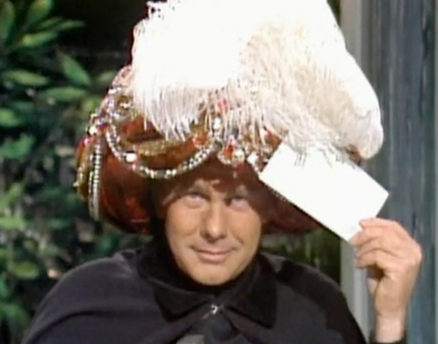

And the answer is…..
Peer reviewed Journicles or even journal articles
The question is How can librarians help you with research assignments?

Slide 20
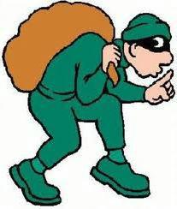




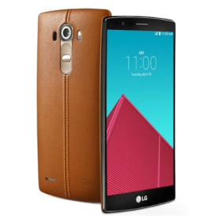

Do not leave personal items unattended.
It only takes a second for you to lose your stuff!
Laptop
textbooks
tablet
smartphone
Backpack

Slide 21



Library Book sale!!!!
ALL BOOKS $1.00
See the bookcase
Pay at the Reference Desk.

Slide 22



Printing and Copying
Use your BravesOne card or purchase a print card to make copies or print
Add money to your card online at http://www.uncp.edu/bs/card/

Slide 23






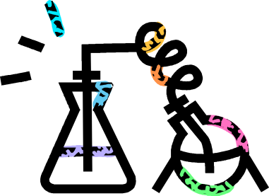
Mutate your research
New Science Databases
Available!
ProQuest Biology Journal
ProQuest
Environmental
Science Package
ProQuest Science
Journals

Slide 24
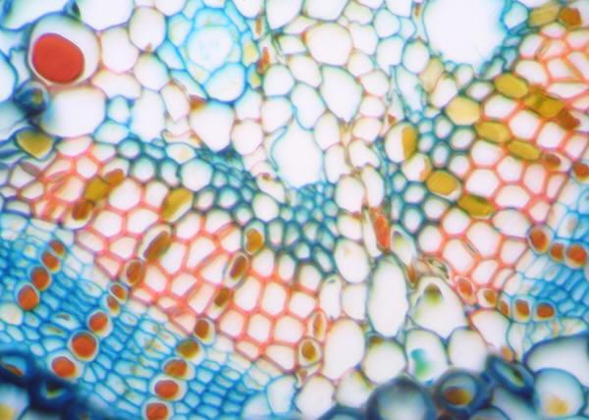
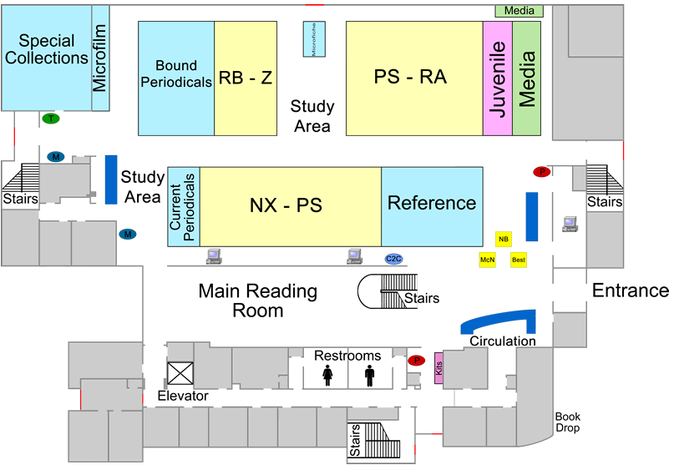
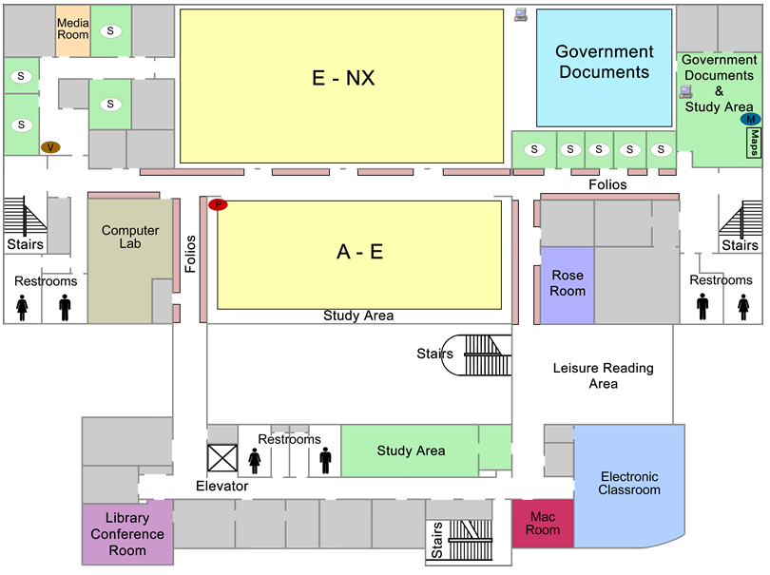
Library Map
First Floor
Second Floor

Slide 25
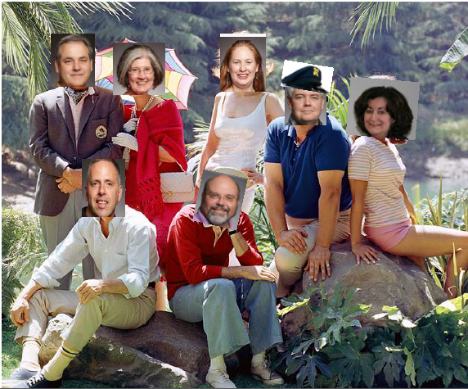

Adrift on the sea of information?
Lost on the web?
Come see us on Reference Island !

Slide 26

Study Rooms
Students must get a key from the
Circulation Desk to use rooms:
240E
240H
All other study rooms are unlocked!

Slide 27
Bookmarks
Have a template
Use textboxes to insert information and graphics
One side for basic contact information
Personalize for groups and events

Slide 28
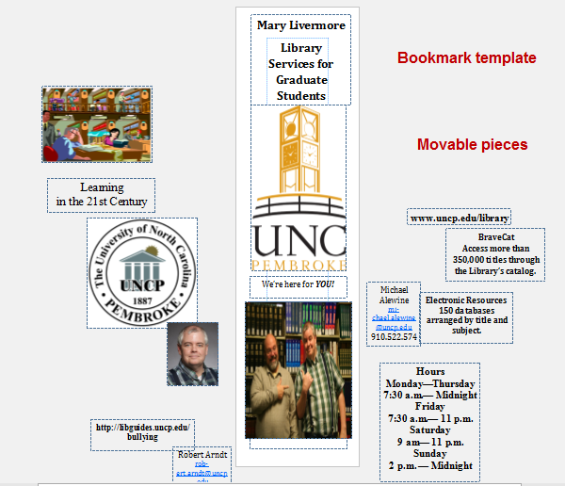
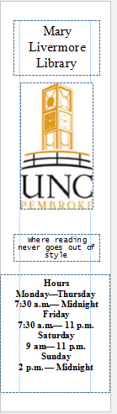
Bookmark template
One side with the basics—
One side specialized for the program or event

Slide 29

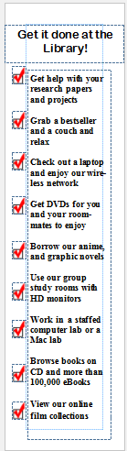
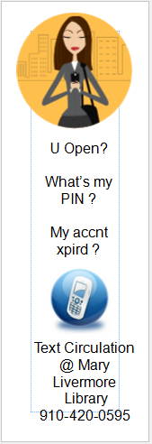

Slide 30



Slide 31
